Slide 1
Recommender System
Team Members:
Kunde Vidya Sagar
Pravin Kundan
P Charith
G M Nithin Sai
Ravi Kiran
Innomatics Research Labs
Guide: Kanav Bansal
Mentor: Akhila
Batch No: 3

Slide 2
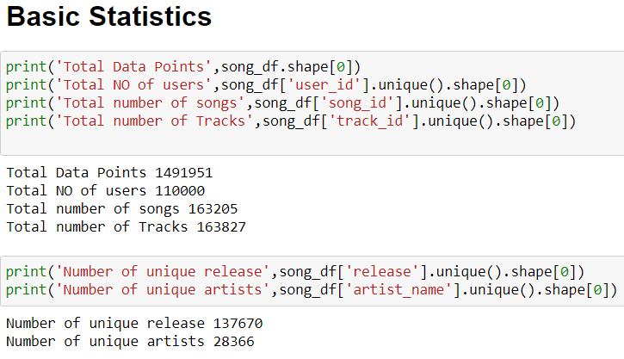
With the data we are knowing about each column present in the
Data and what it infers

Slide 3
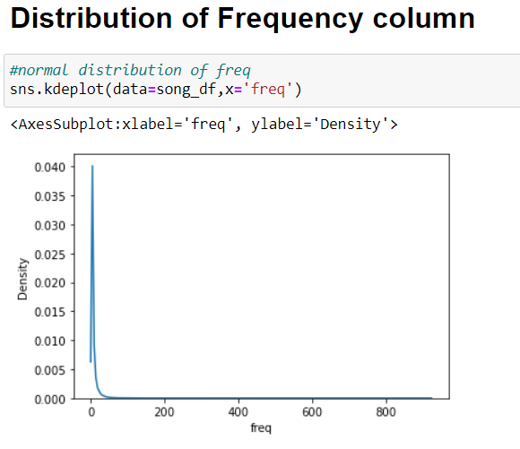
Freq column in the data tells about the frequency of the song
Frequency of The song tells About how many times does the song repeated by the user
The plot shows how the frequency was distributed mostly users listen few songs at regular interval of times this will helpful to know about frequency of each song

Slide 4
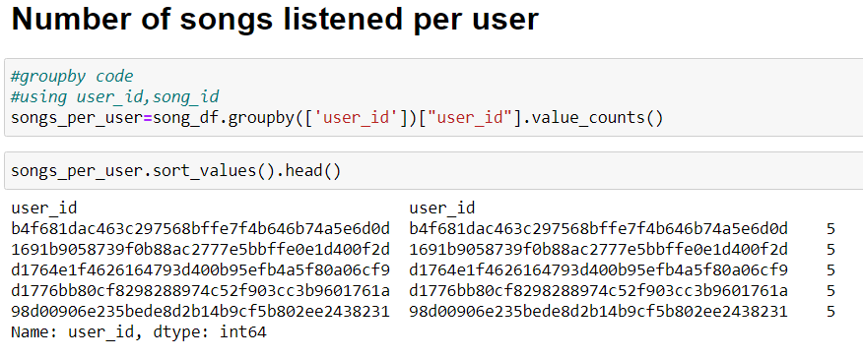
User_id is the column which contains id of each user and with this user id we can know how many songs are listened by each user and we can recommend the songs according to it and we can also give benefits to the user who listens the songs more and we can improve his recommendations too.

Slide 5
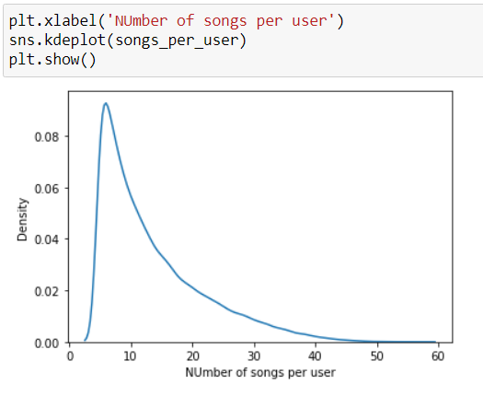
This graph shows us that most of the users listen to 10 songs
And few people listen 30+ songs in the songs listed in the song_id column

Slide 6
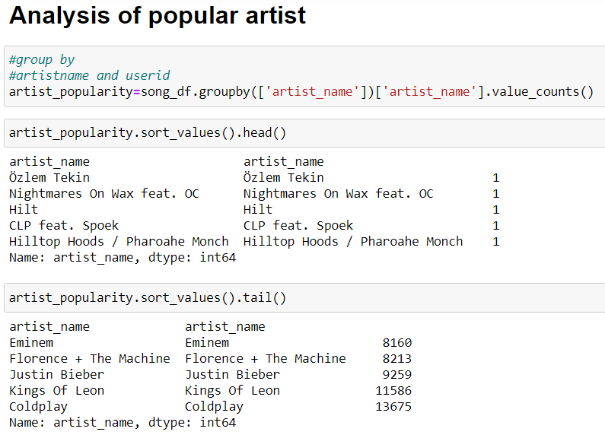
We can know about popular artist by knowing how many users are listening the songs of those artists from this we can recommend popular artist playlist to a new user and also future recommendations from the particular user
In the above code we can see that coldplay is most popular artist and we can recommend those artist to new user

Slide 7
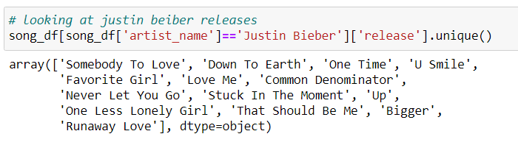
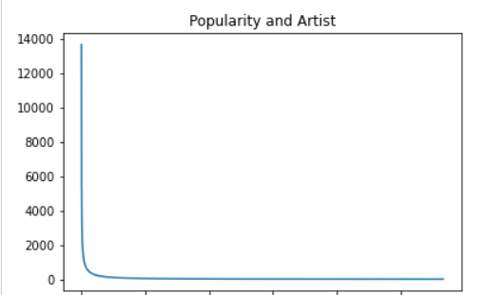
The above code shows the all songs of Justin beiber and we can create a
Playlist with the data.
The graph shows popularity of artist and most of the people likes to listen to the most popular album so we can recommend that to the users

Slide 8
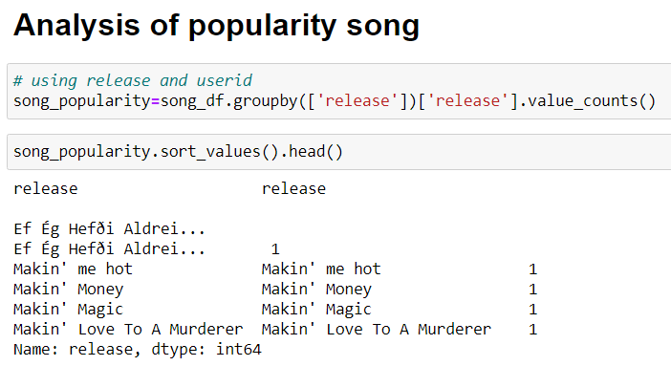
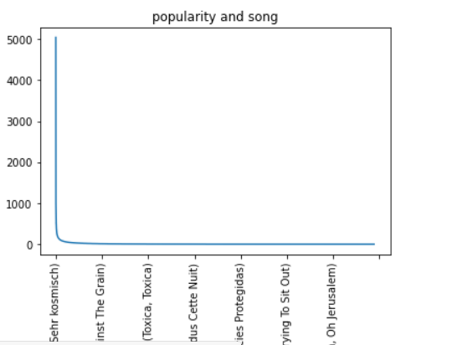
This code shows they most popular song irrespective of the artist and from this we can recommend a playlist with the most popular song and this also can be recommended to new user
The graph shows popularity of song and most of the people likes to listen to the most popular song so we can recommend that to the new users

Slide 9
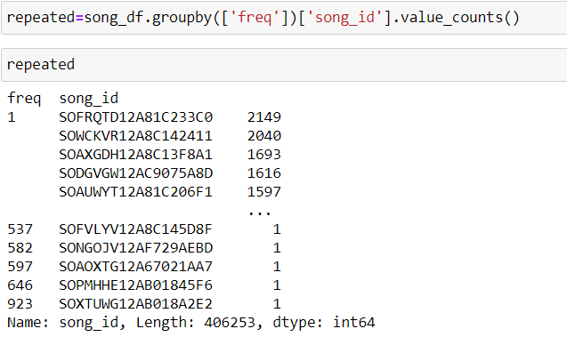
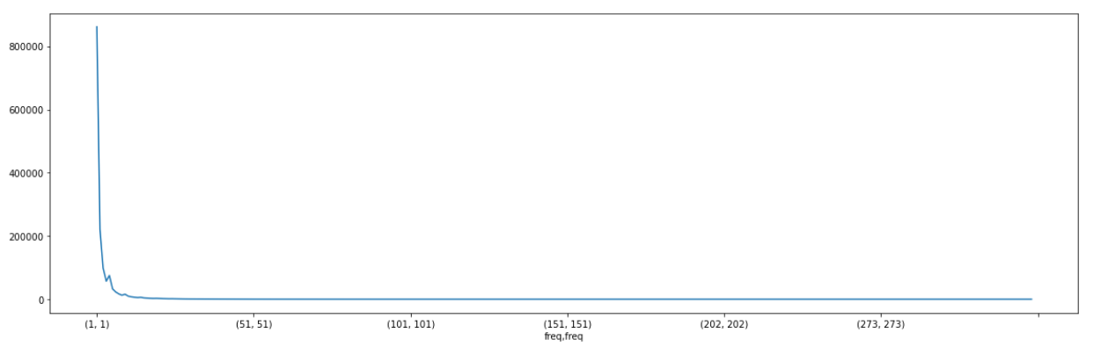
This code shows that how many times does the song listened by the users and we can see the song id and how many times it is repeated by users and the below graph shows its distribution

Slide 10
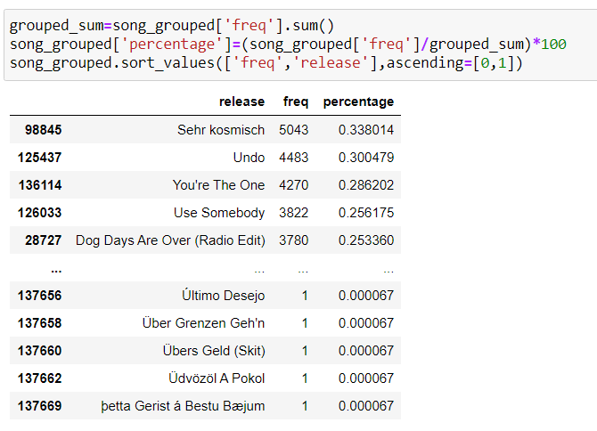
Here is the data of songs released and its frequency and also percentage of popularity of songs, so with this data we can recommend a popular based recommender system

Slide 11
Thank You

